Slide 1
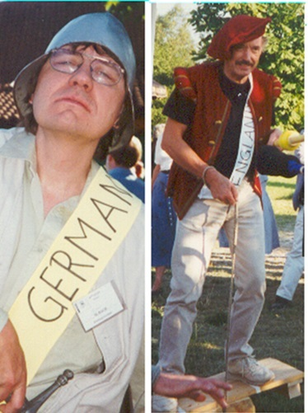
1.
The start of brexit?

Slide 2
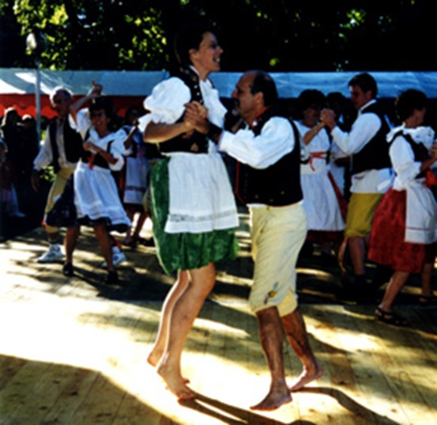
2.

Slide 3
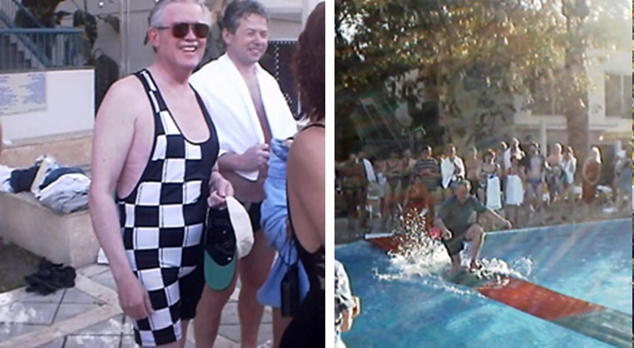
3.
Team Americas has a chequered past

Slide 4
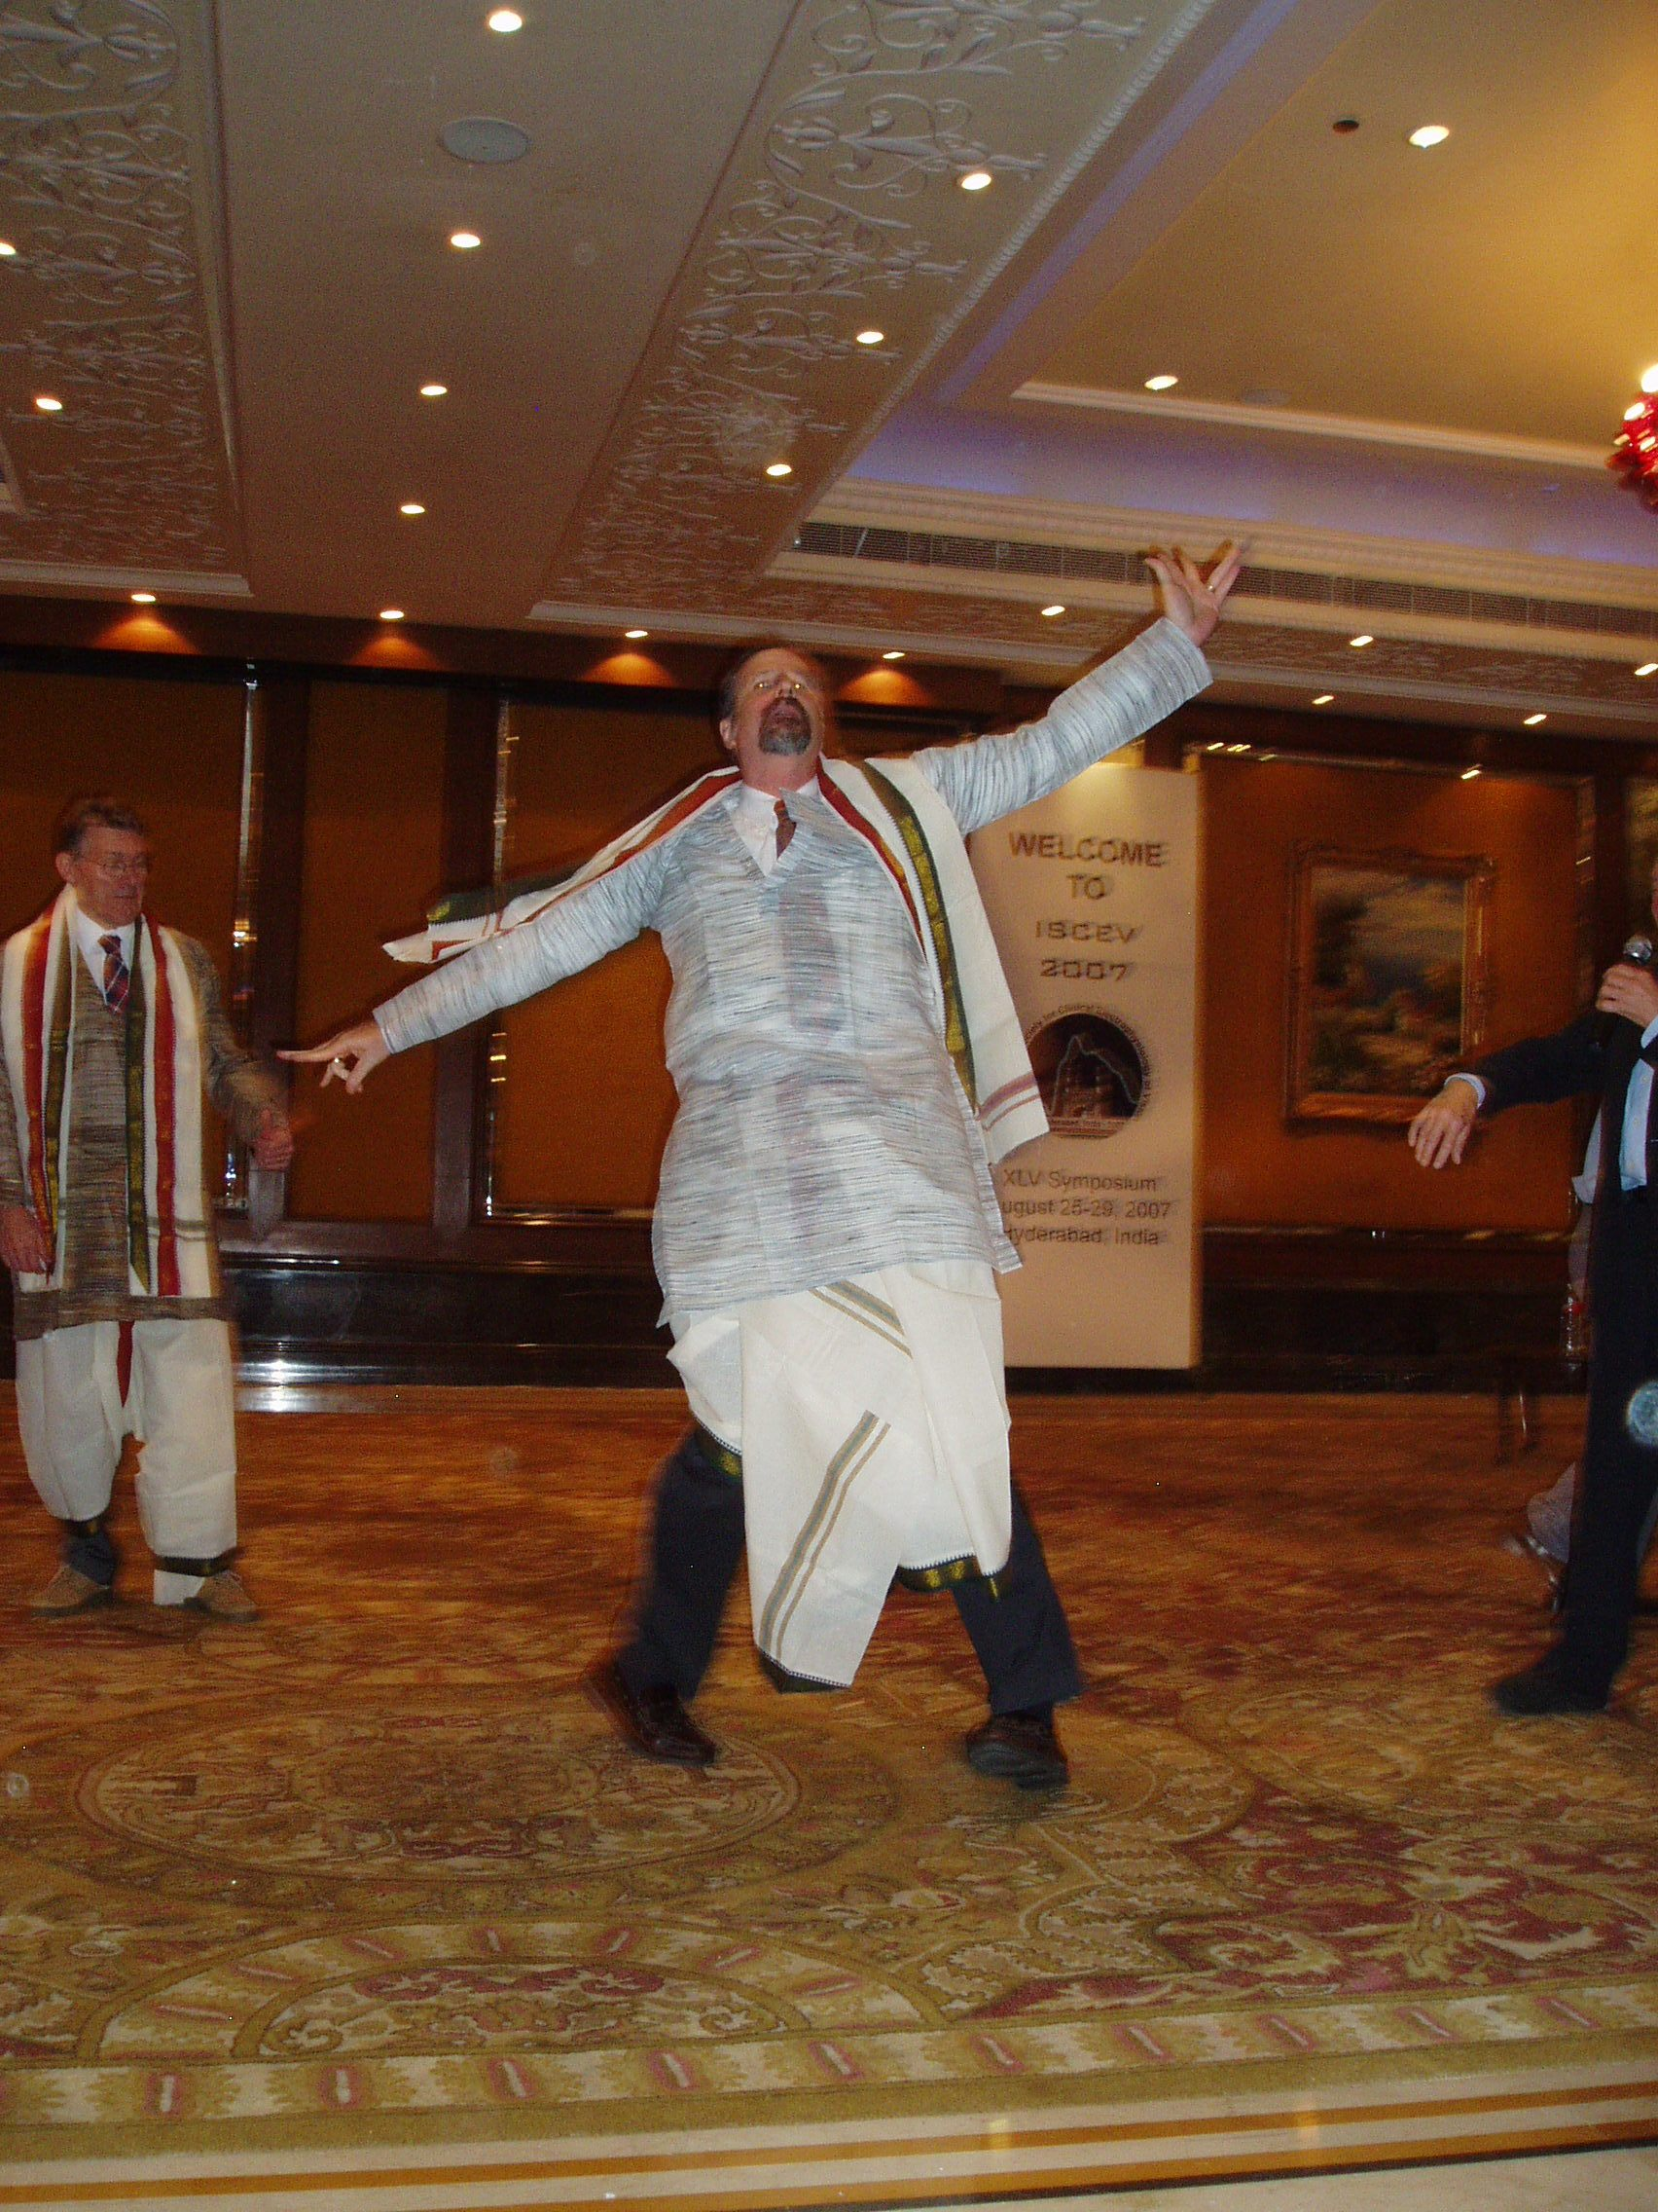
4.
An early prototype for the statue of liberty?

Slide 5
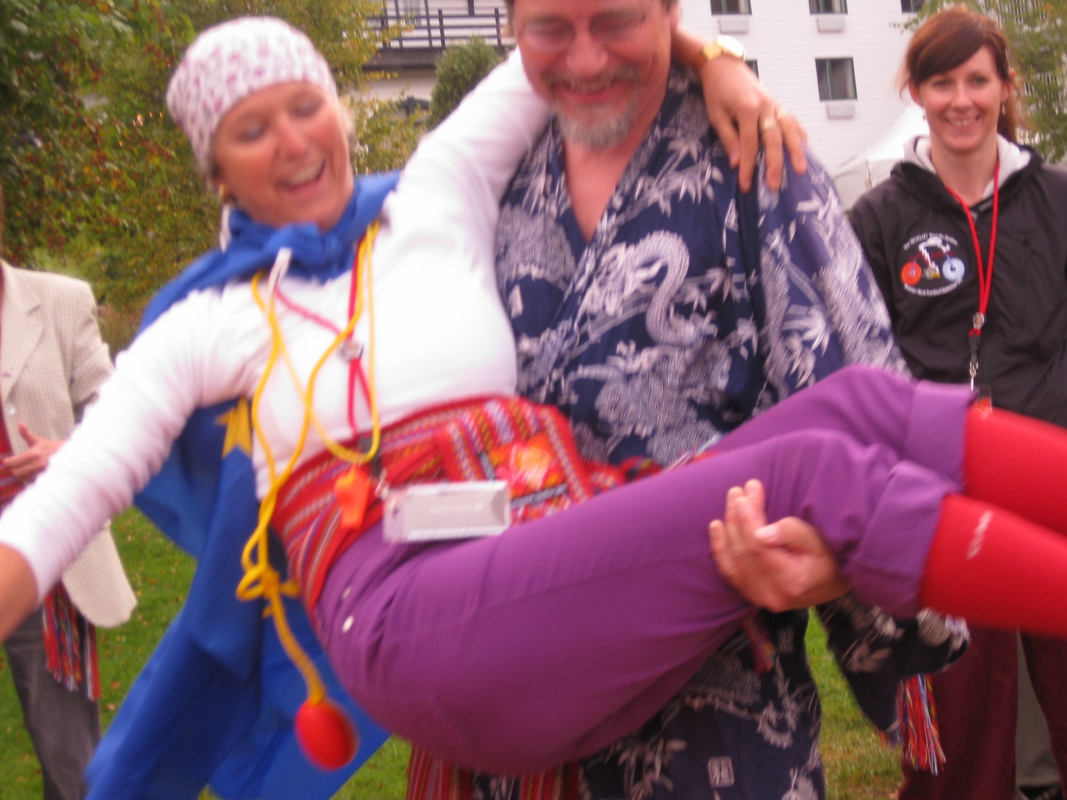
5.
Good to have somebody to carry the team

Slide 6
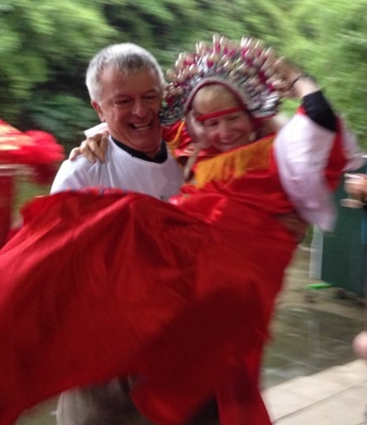
6.
Good to have somebody to carry the team
Mary, Mary, how does your garden grow?

Slide 7
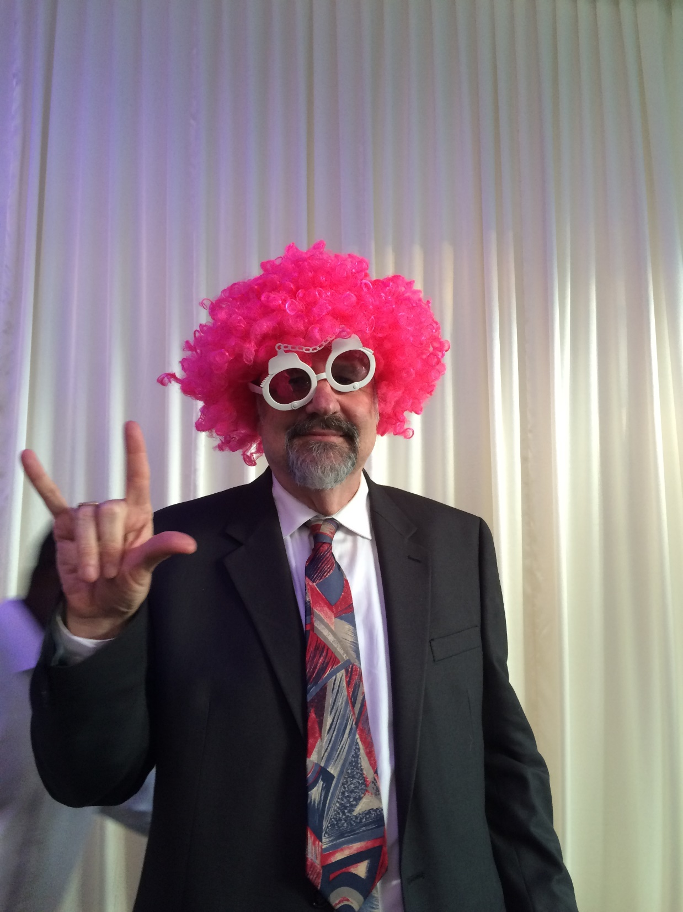
7.
The public face of electrophysiology?

Slide 8
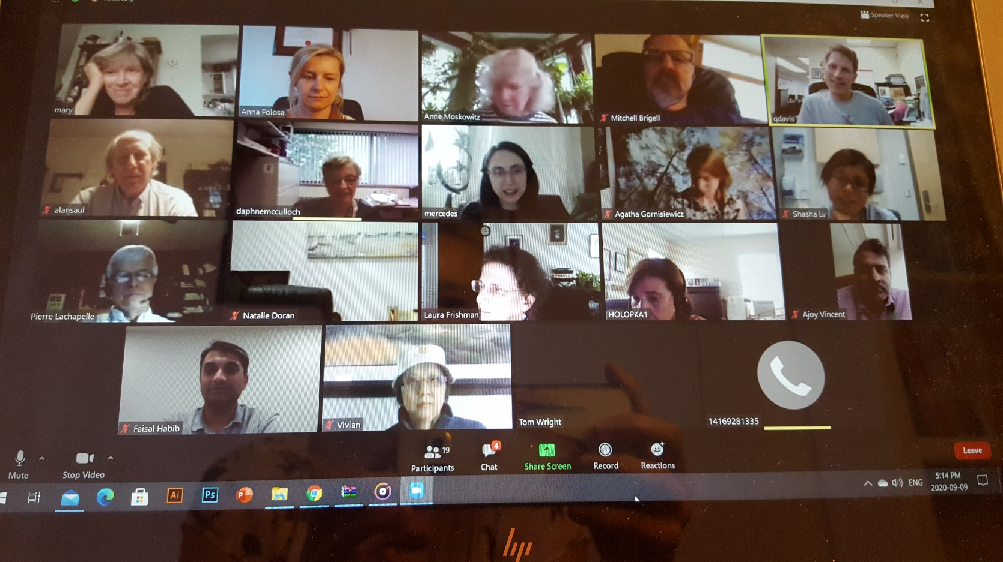
8.
Business up top, don’t look below.

Slide 9
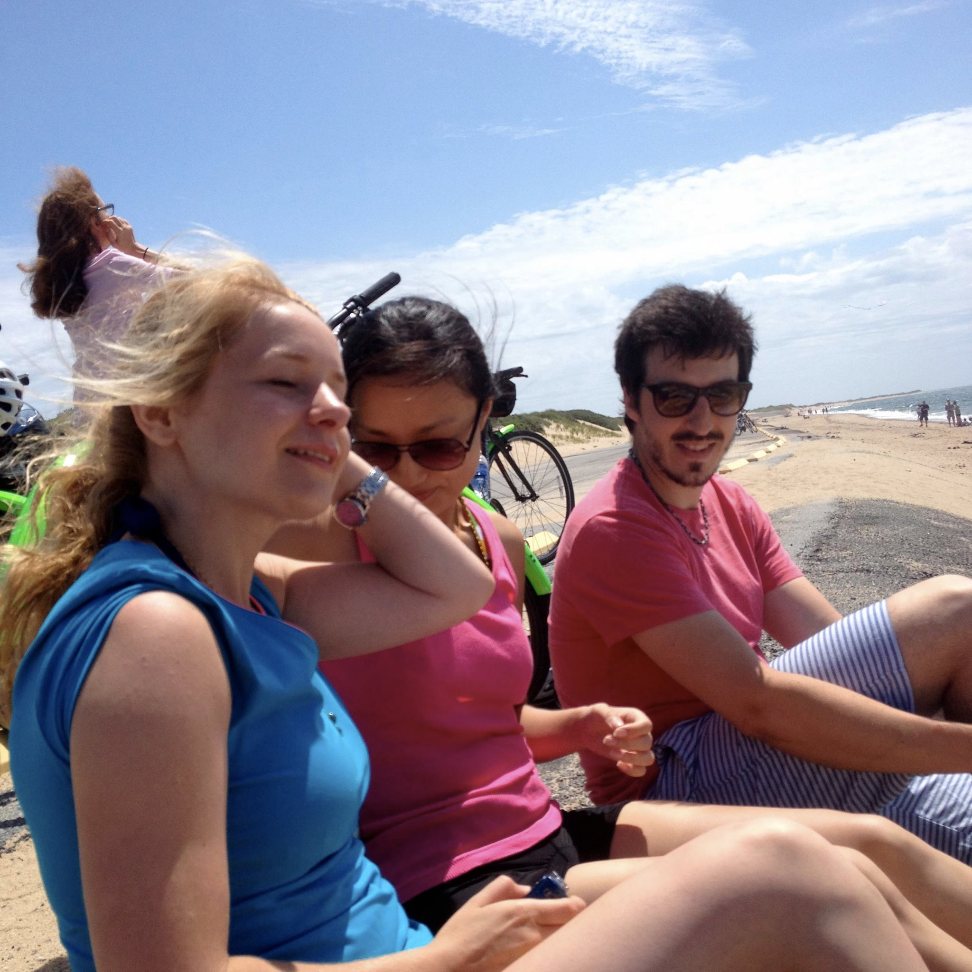
9.
What should have been.

Slide 10
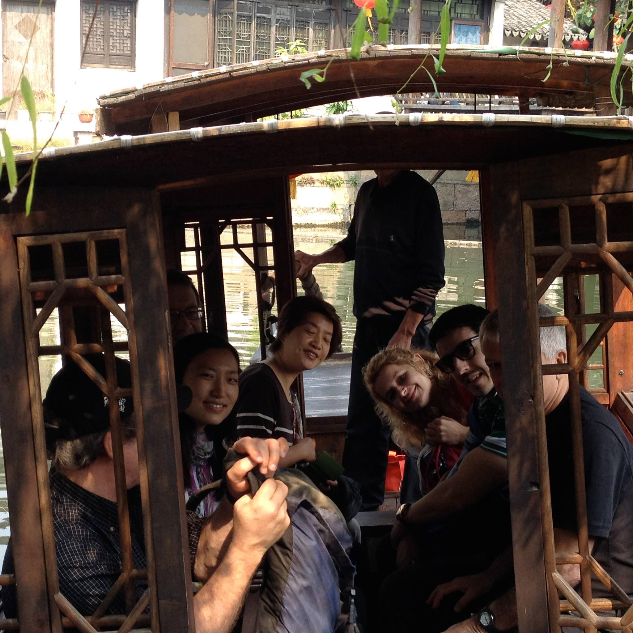
10.
Little do they know, it’s a one way trip.

Slide 11
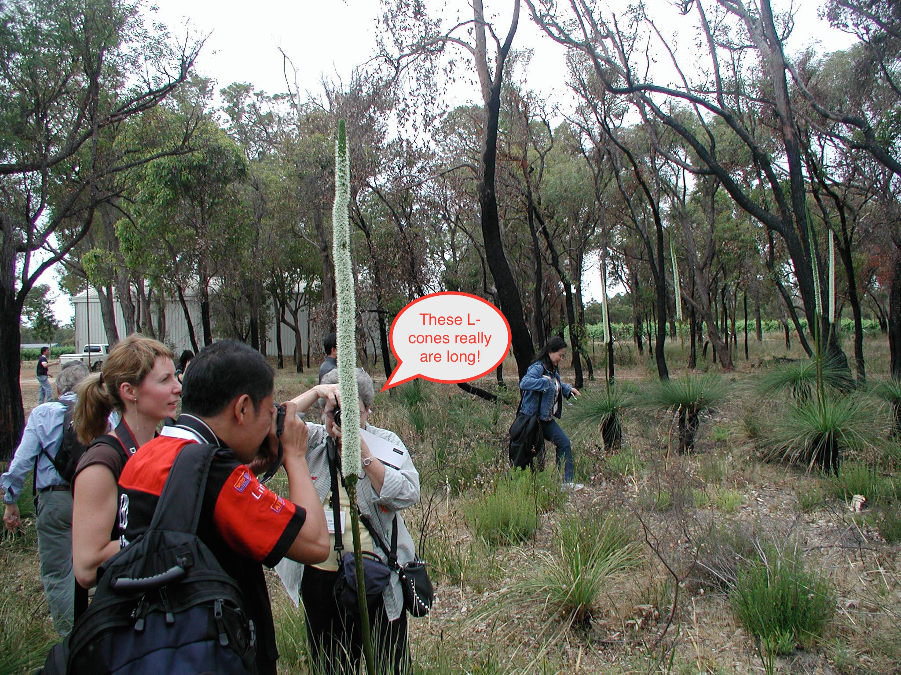
11.

Slide 12
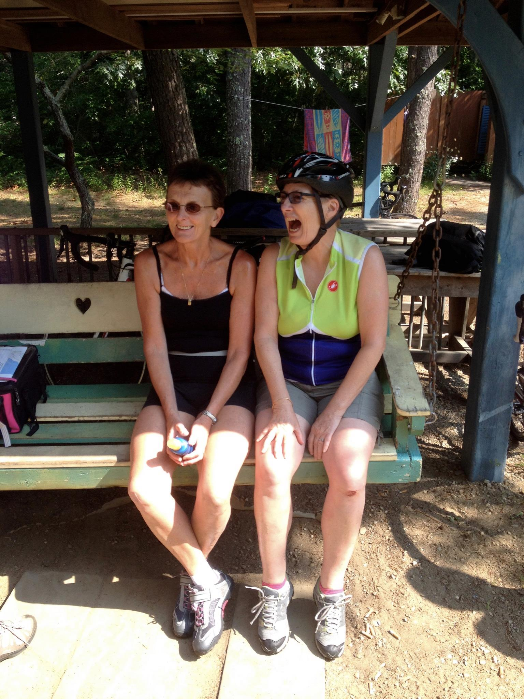
12.

Slide 13
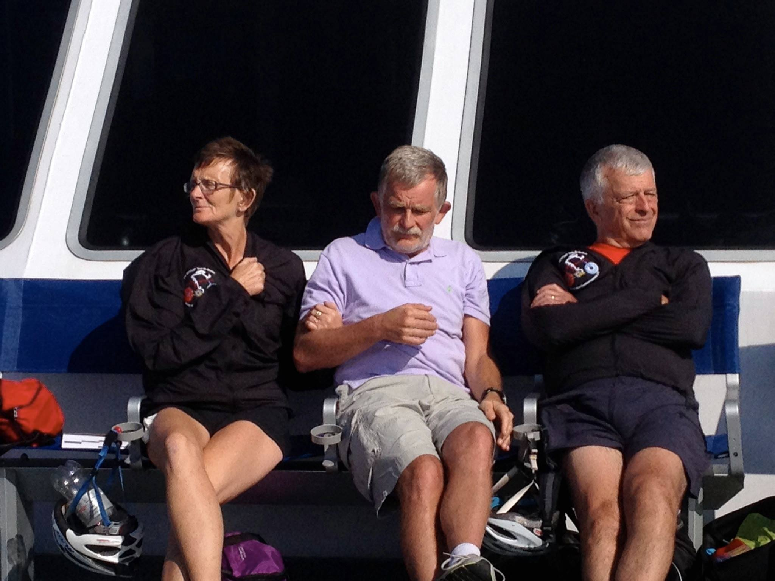
13.
Hey, no airports this year.

Slide 14
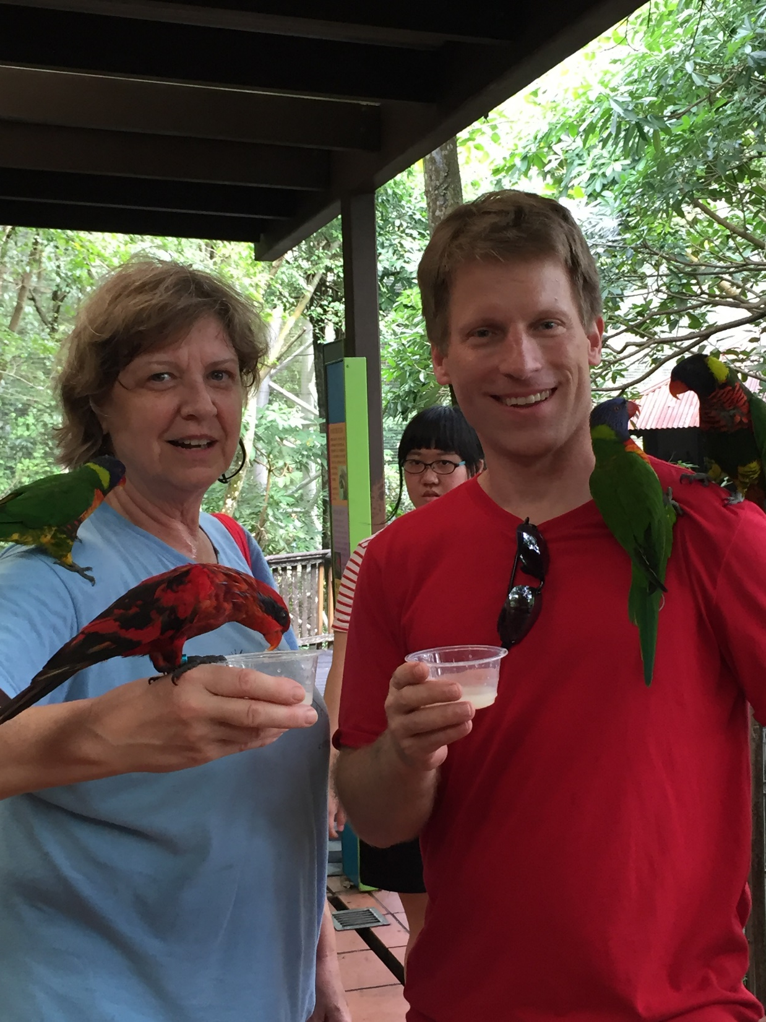
14.
Bird brains

Slide 15
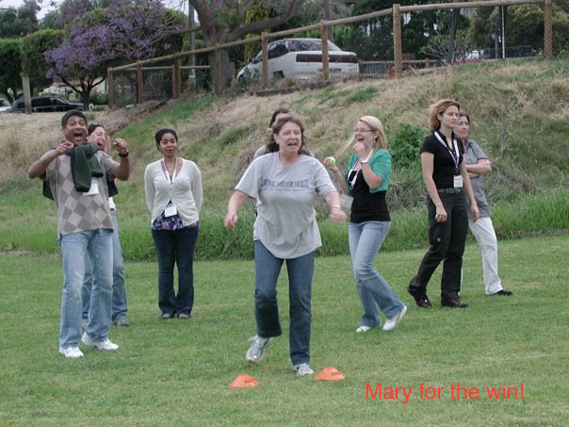
15.

Slide 16
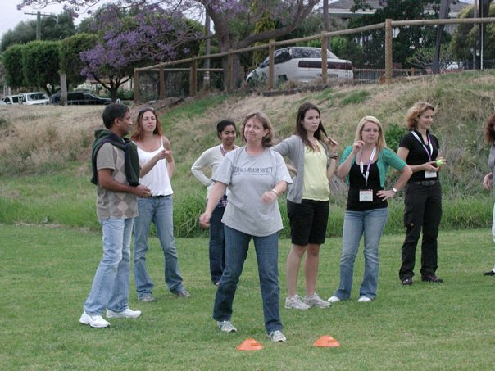
16.

Slide 17
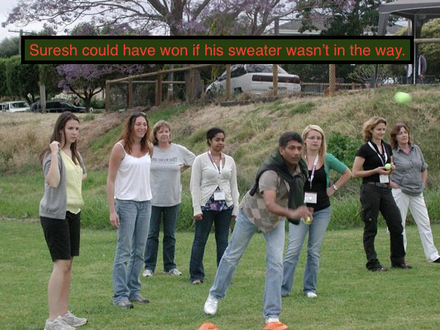
17.

Slide 18
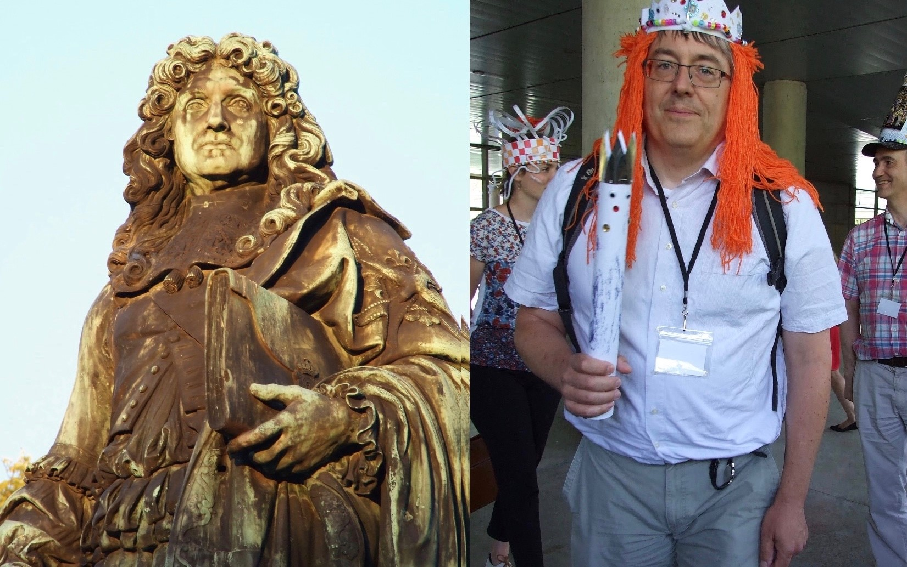
18.
Doppelganger

Slide 19
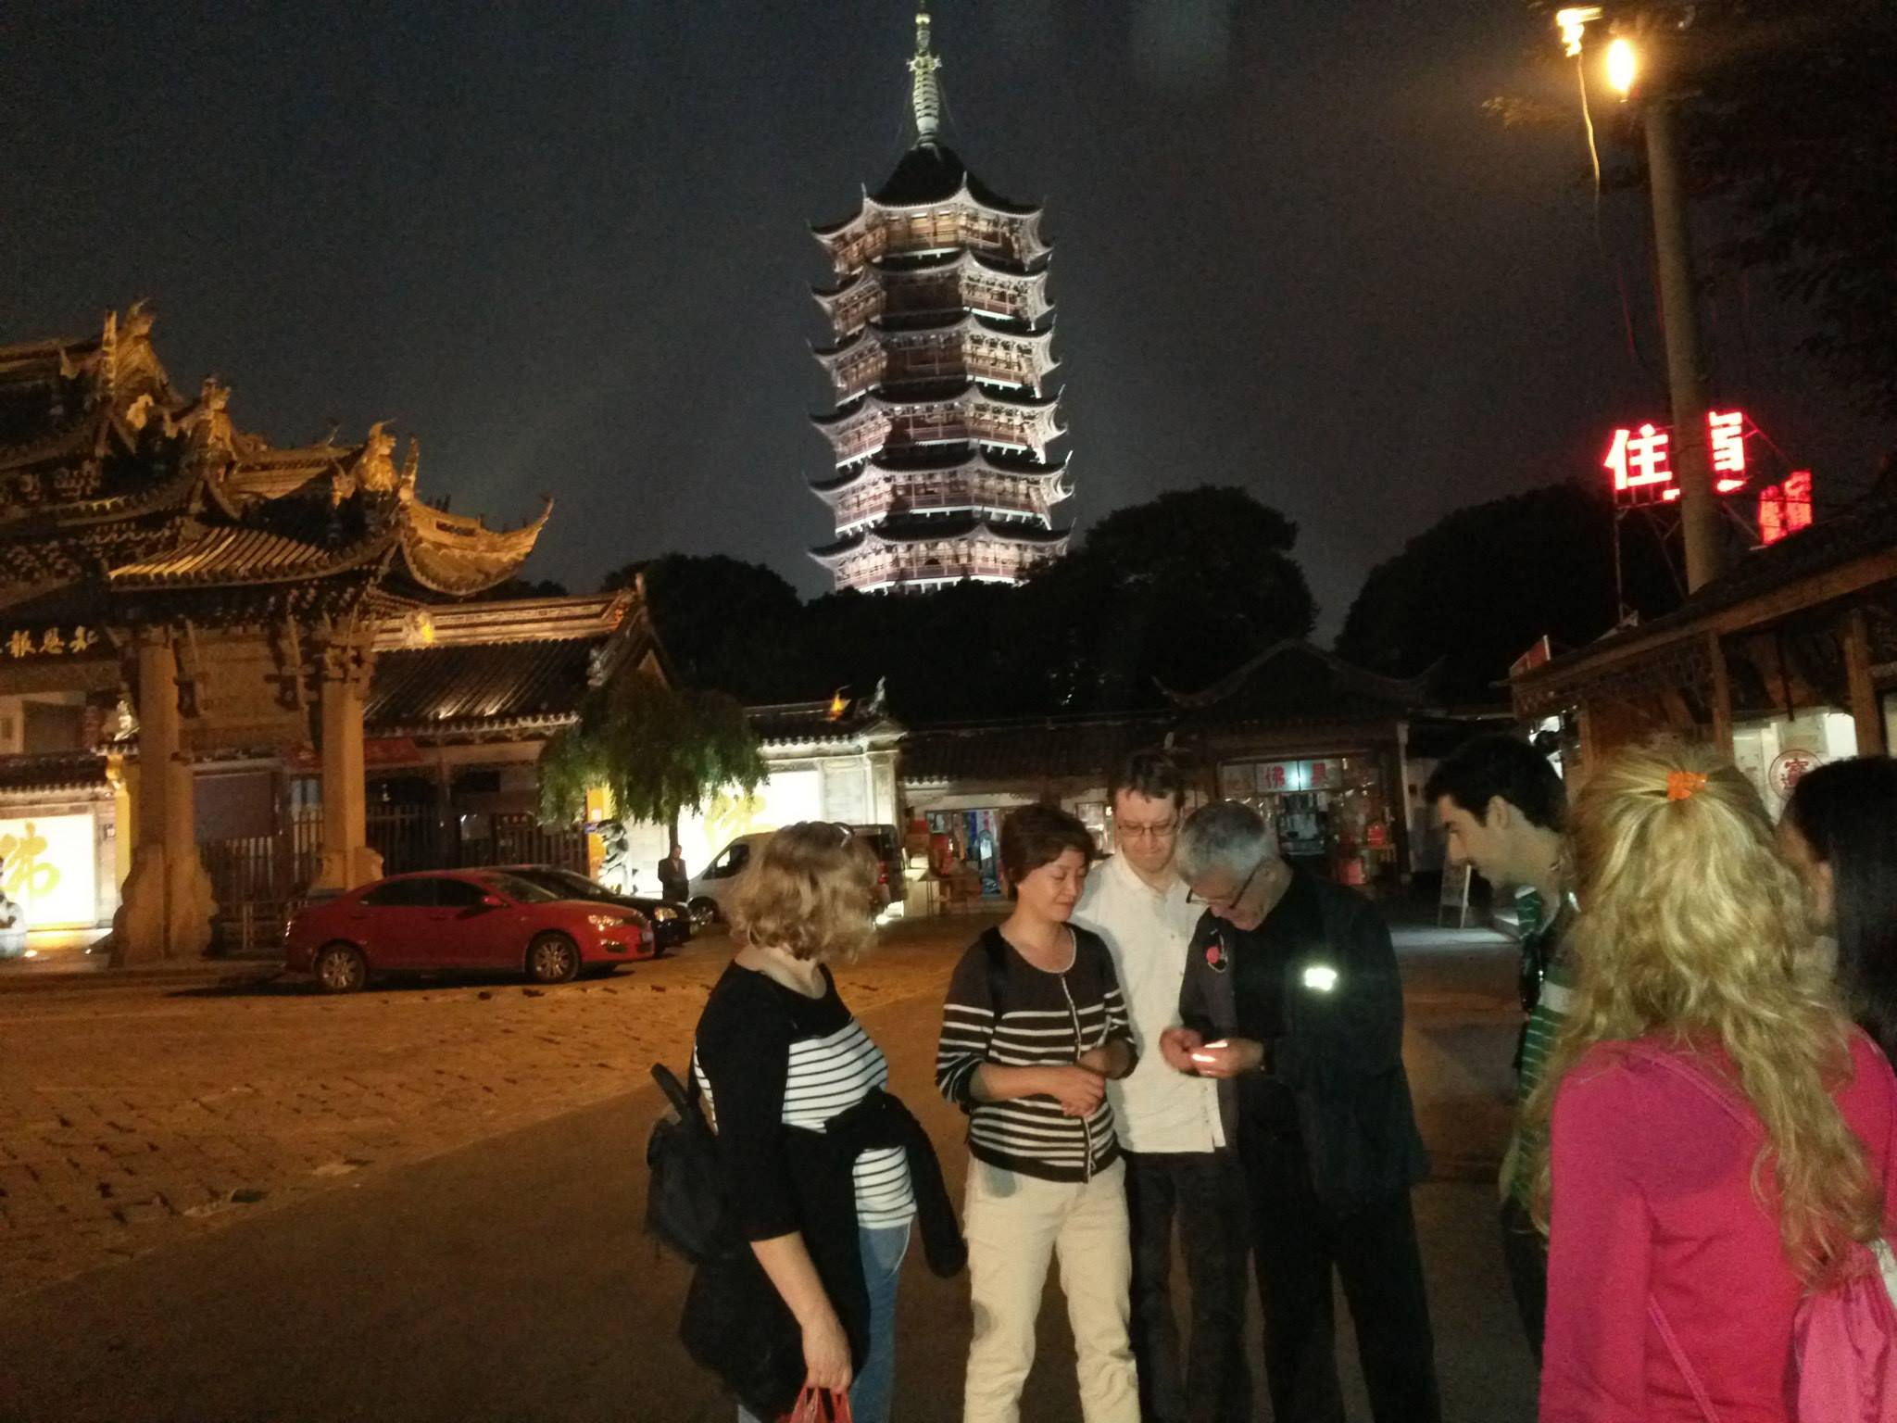
19.
His heart beats for ISCEV

Slide 20
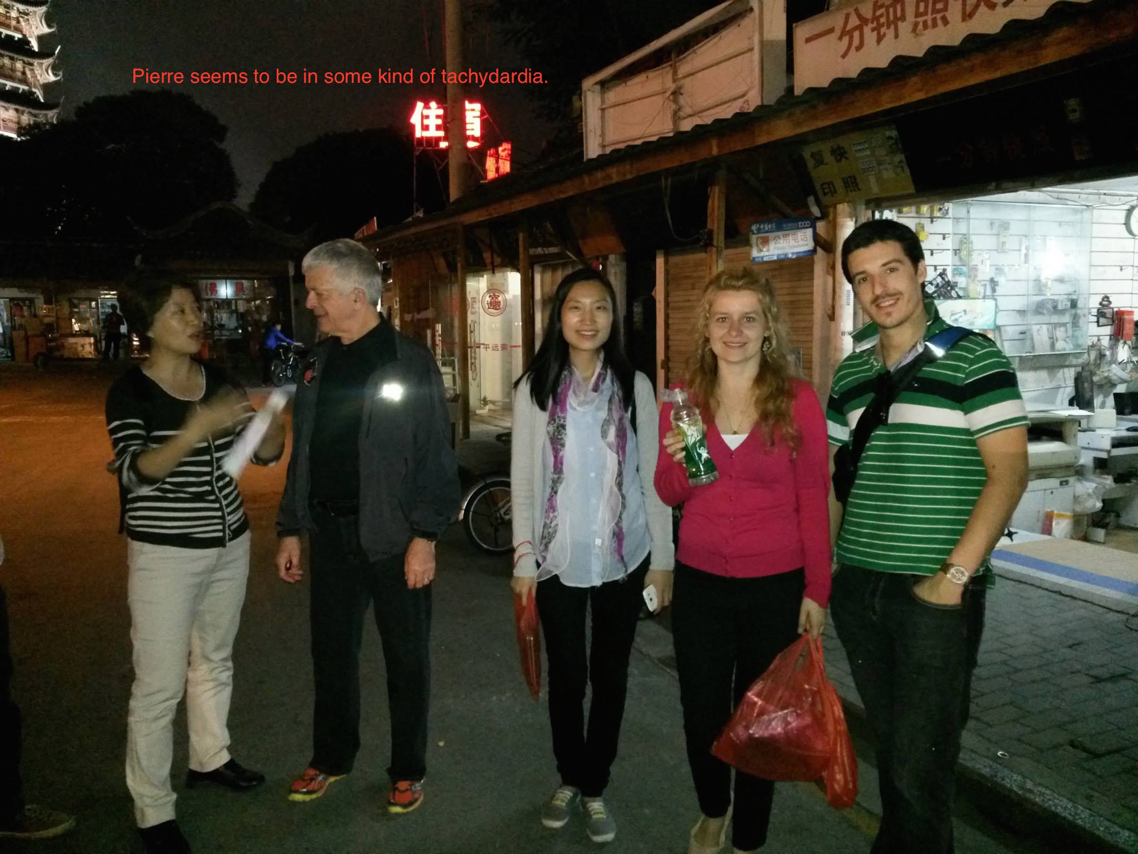
20.

Slide 21
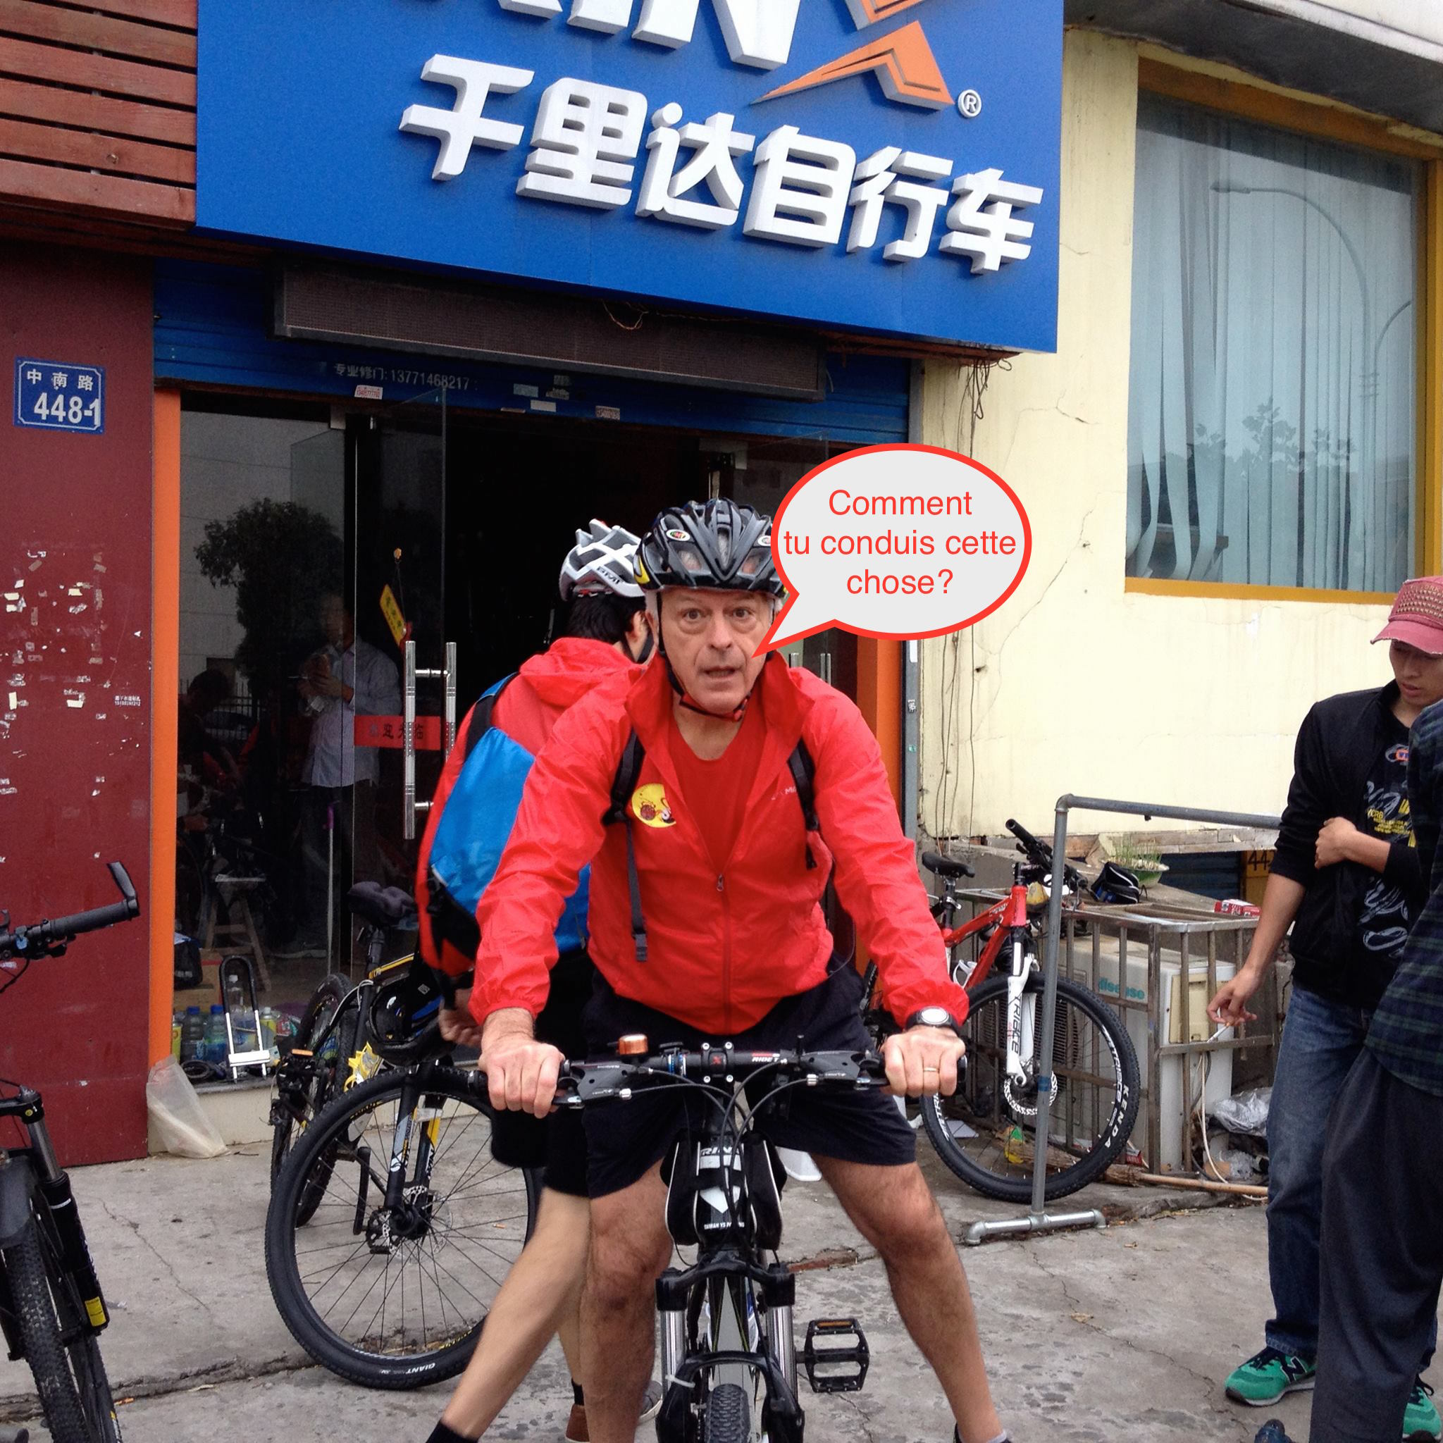
21.

Slide 22
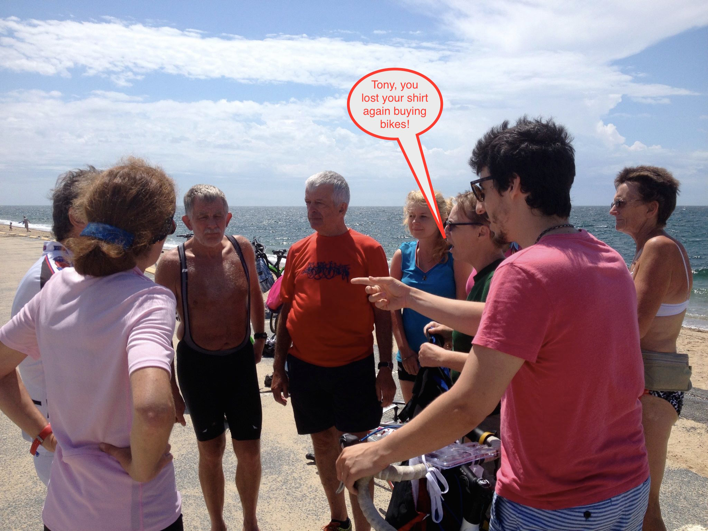
22.

Slide 23
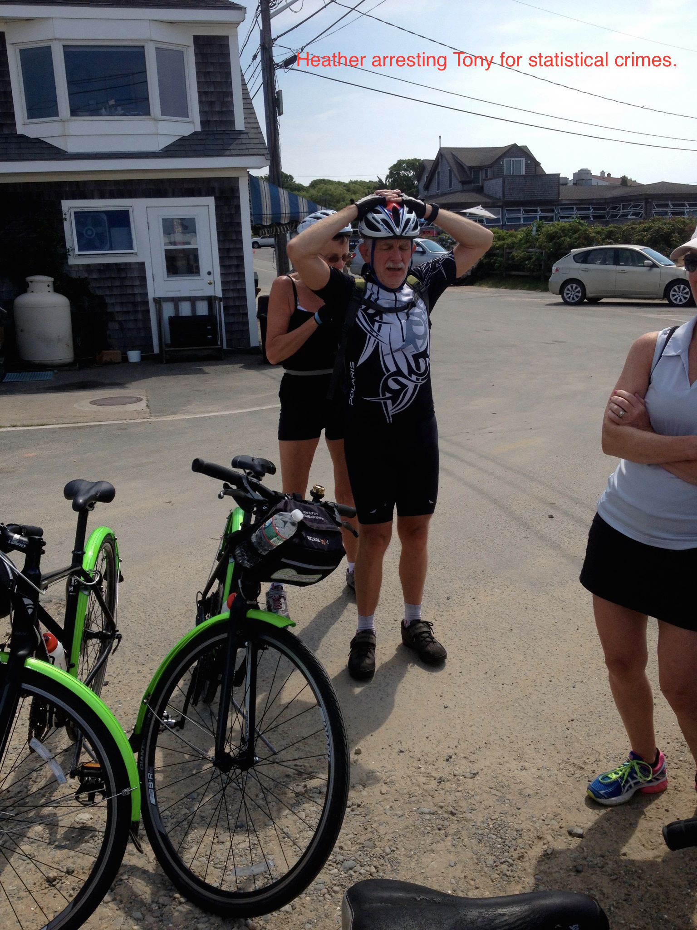
23.

Slide 24
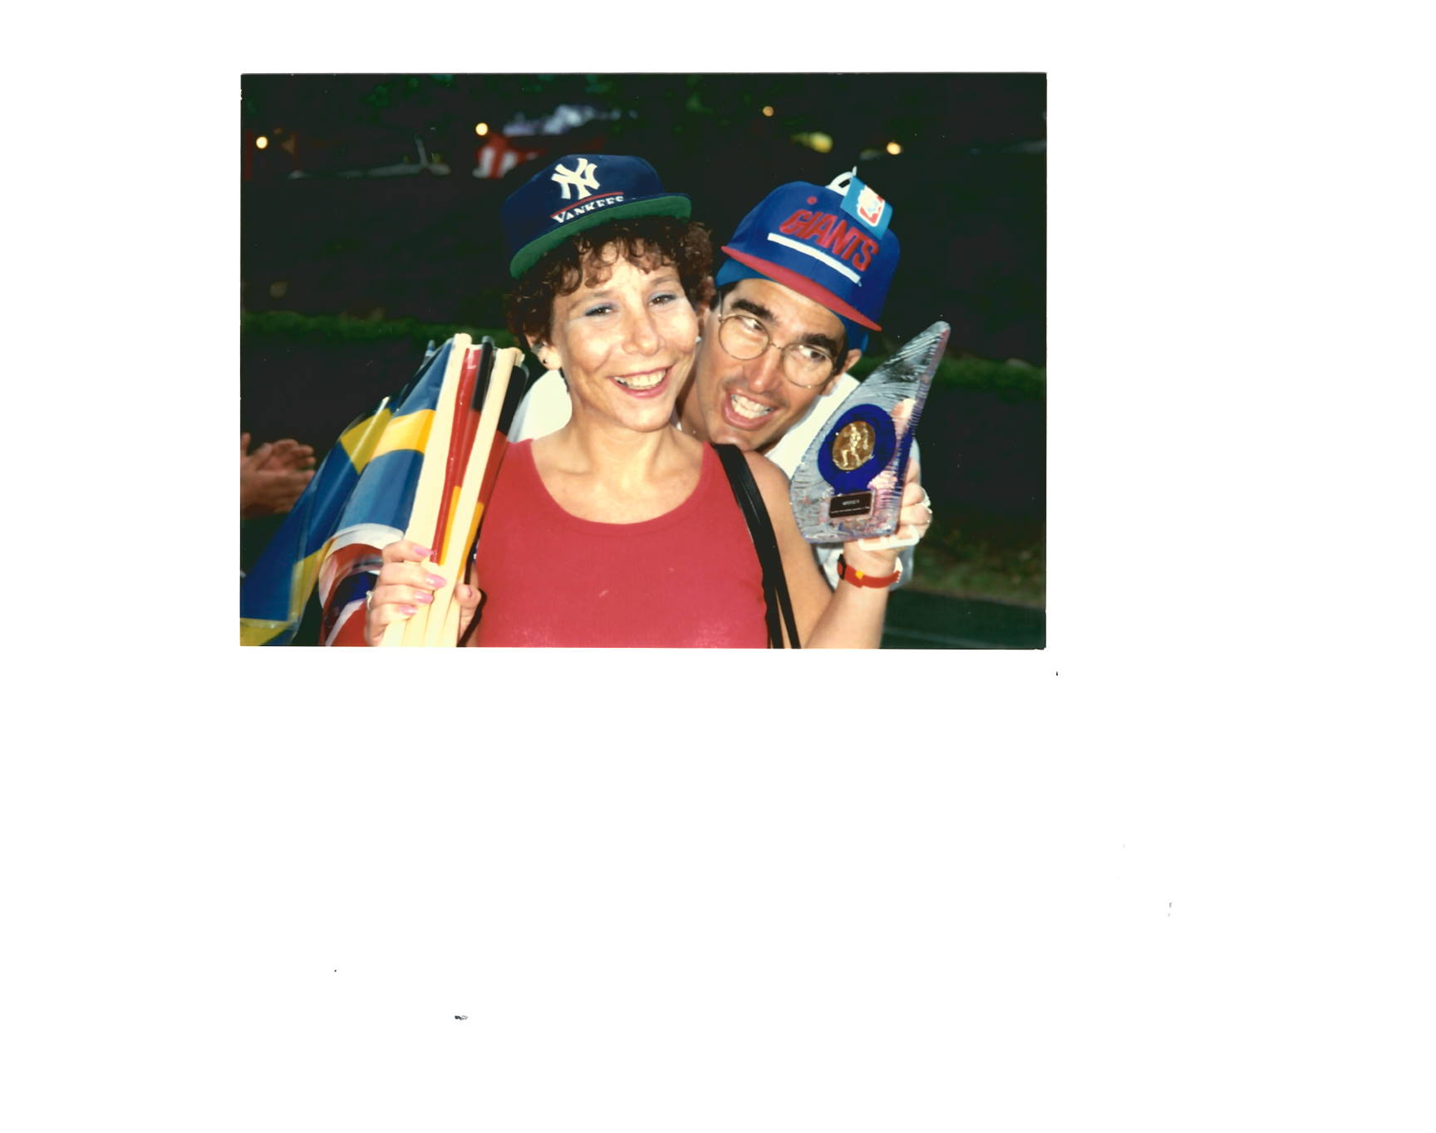
24.
Don’t tell Colin, but the Americans DID win a trophy at the first ISCEV Olympics in Chiba, Japan.

Slide 25
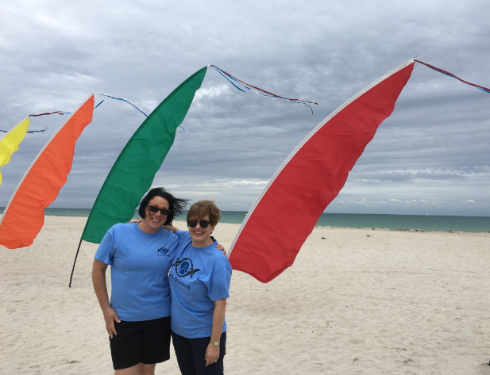
25.
Who said electrophysiology was a breeze?

Slide 26
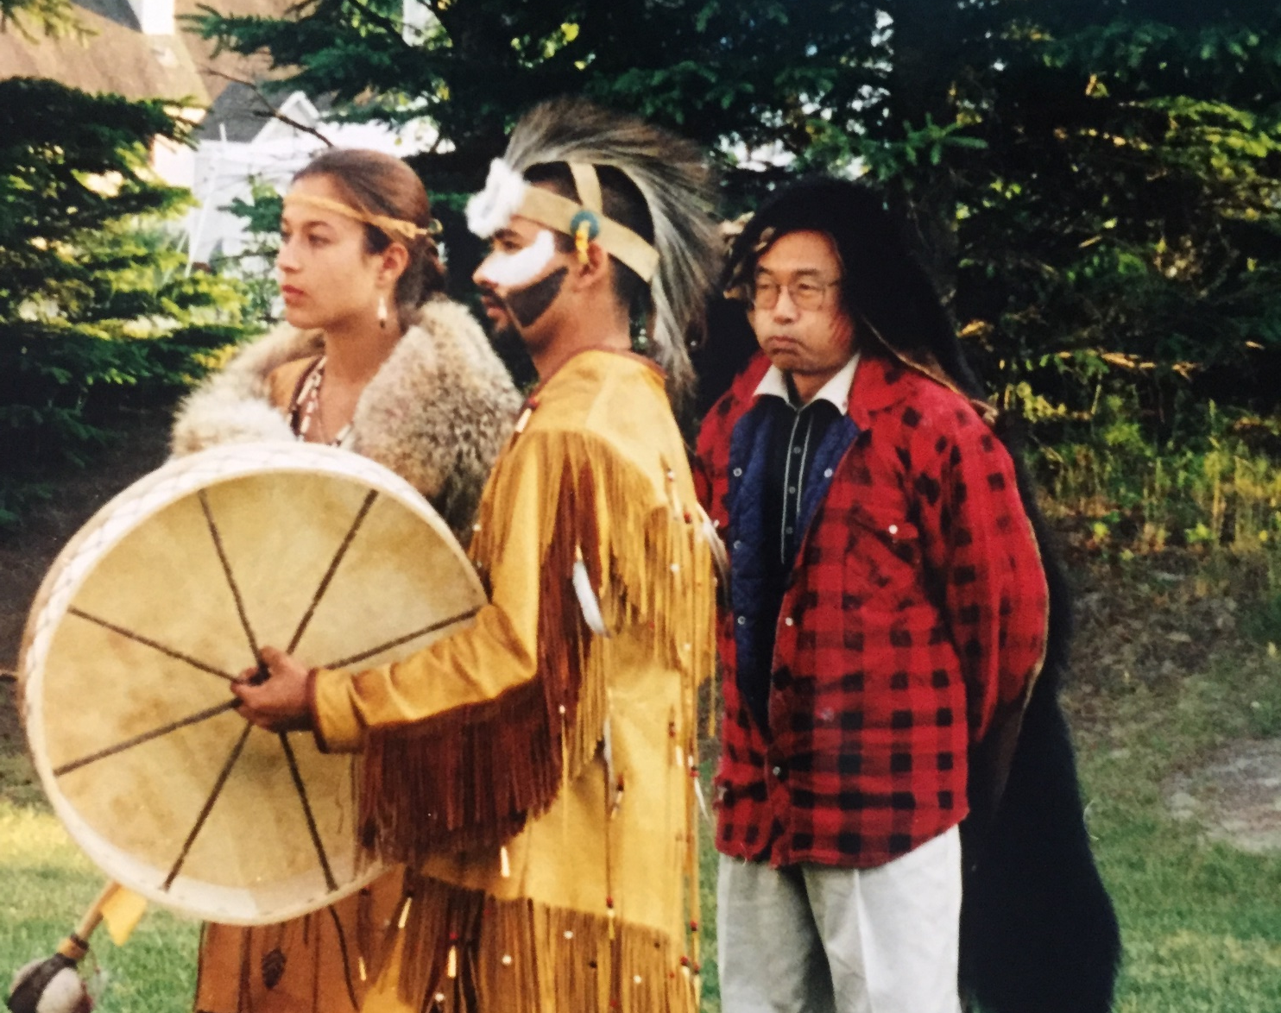
26.
Cultural appropriation anyone?

Slide 27
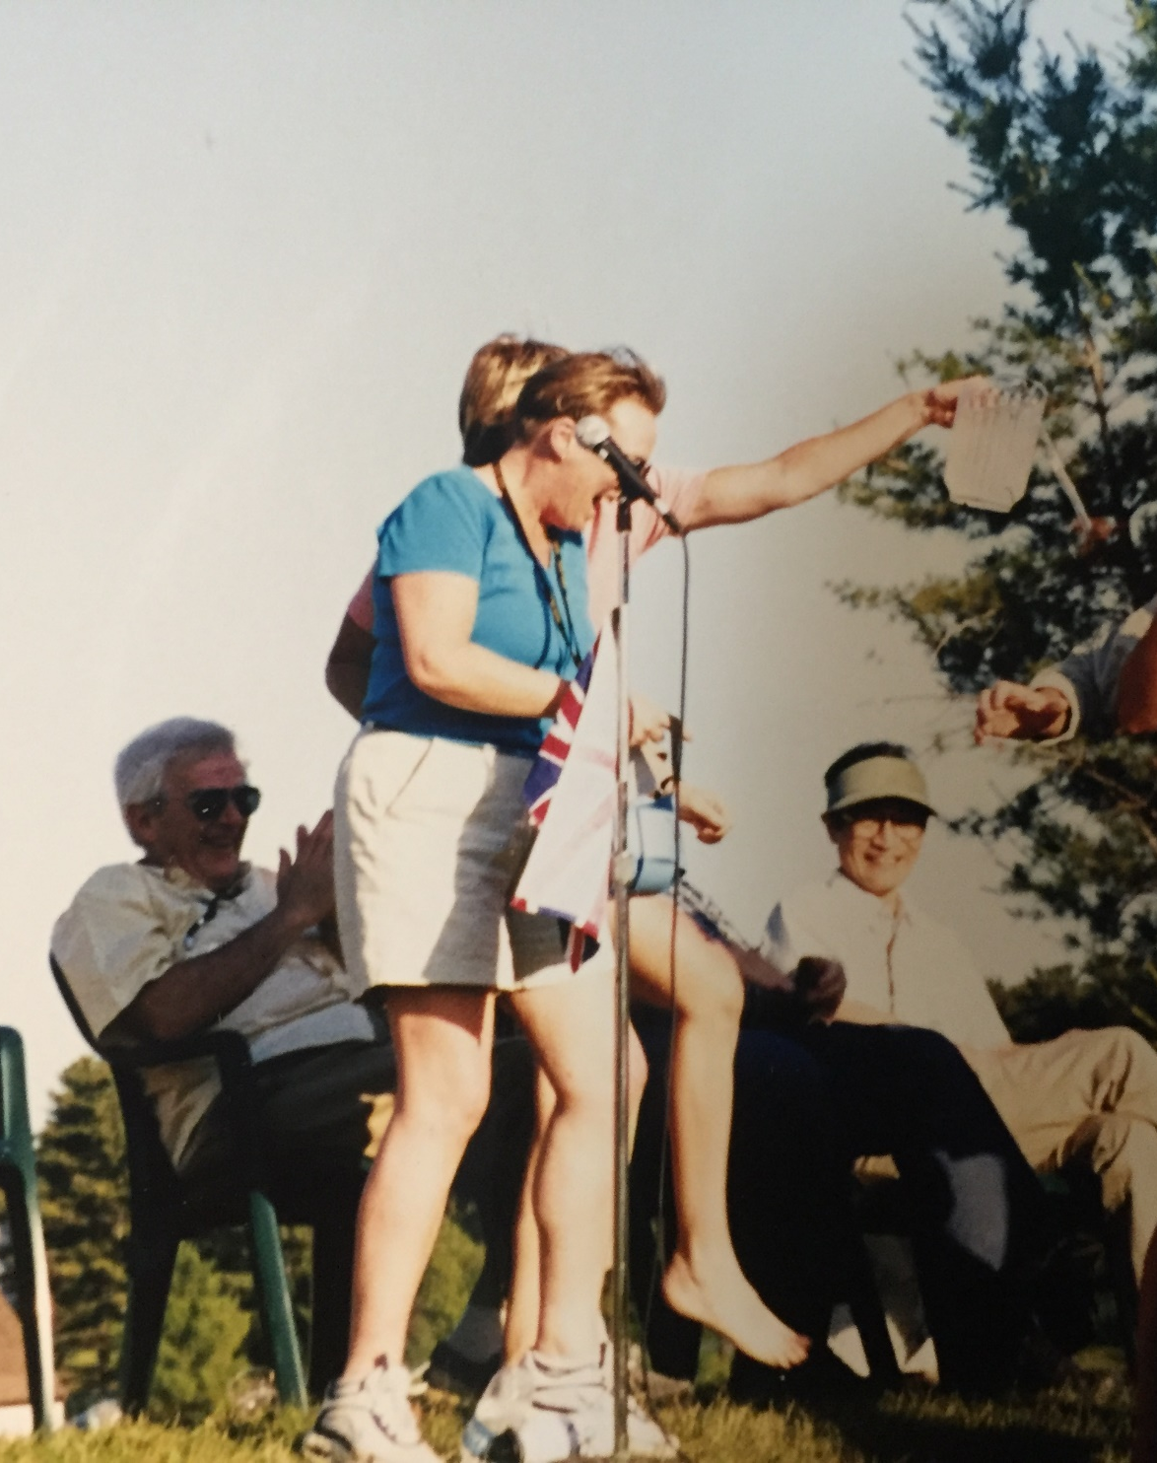
27.
I thought Carol was banned from the UK?

Slide 28
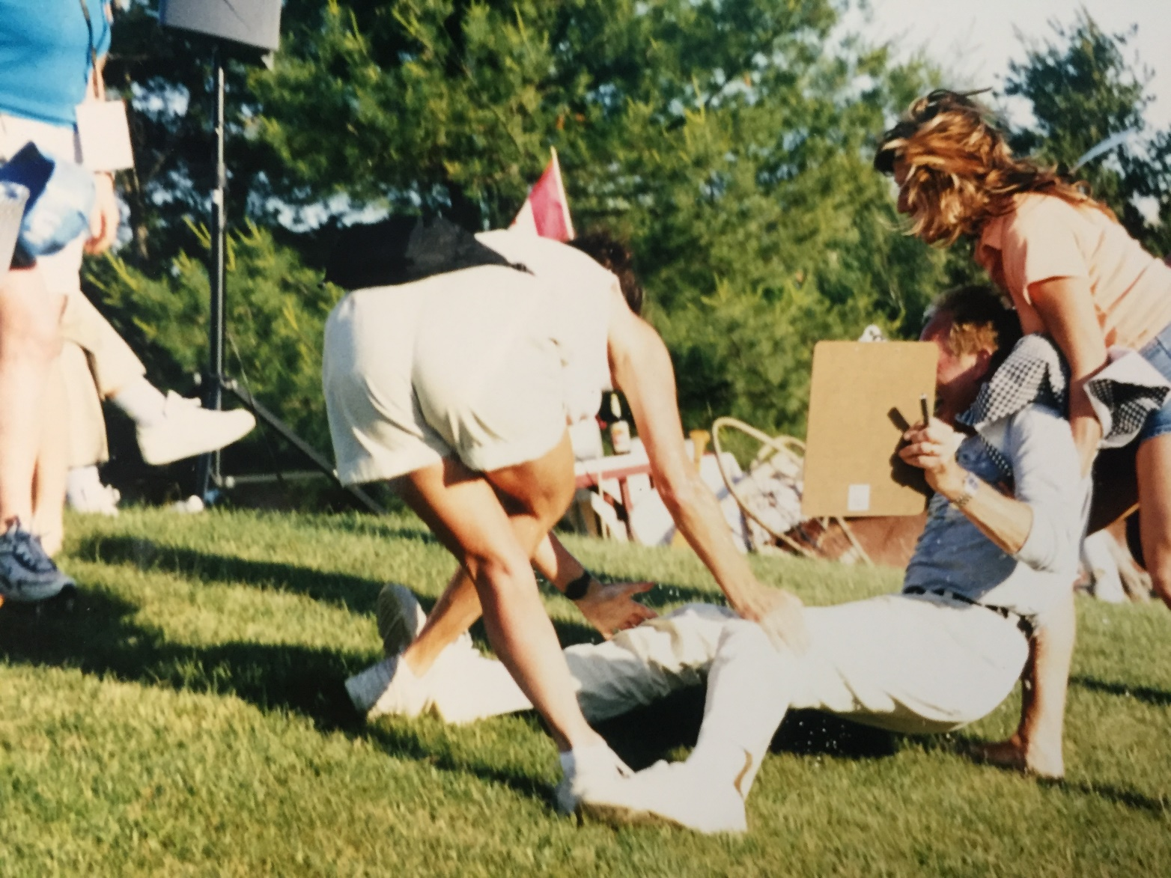
28.
That’s not how you play twister.

Slide 29
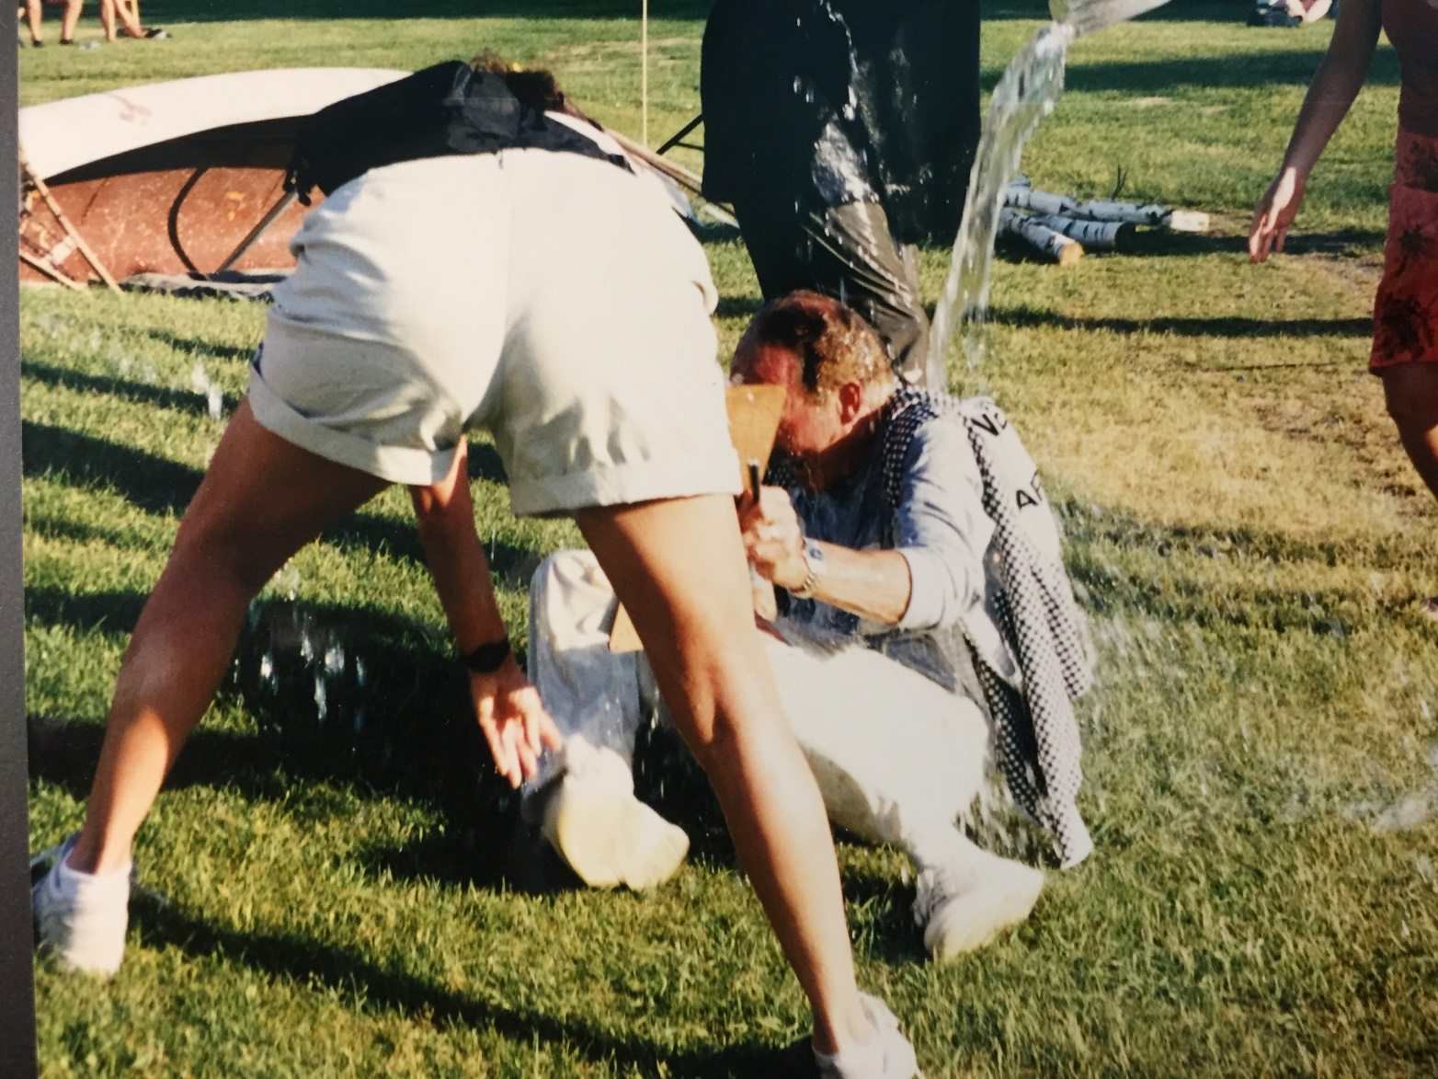
29.
So many butts about this picture.

Slide 30
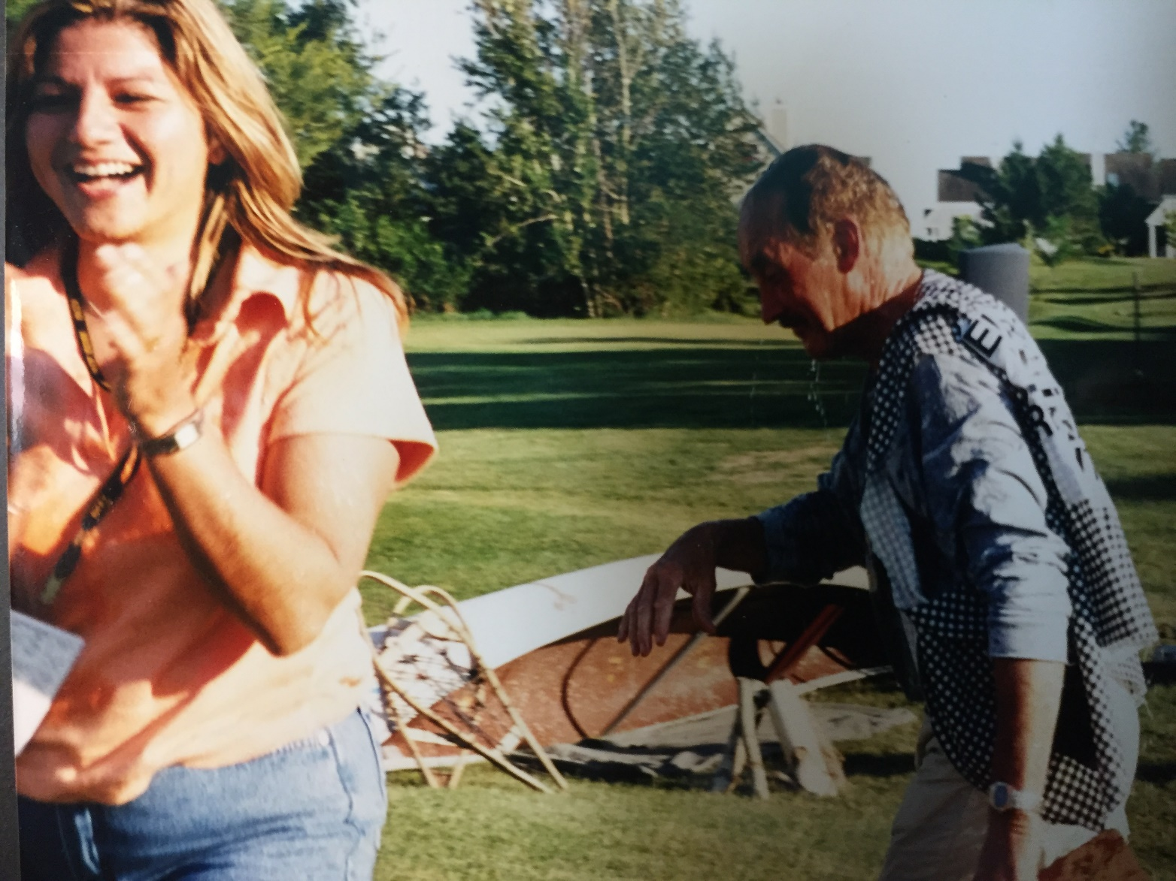
30.
And they all lived happily ever after.

Slide 31
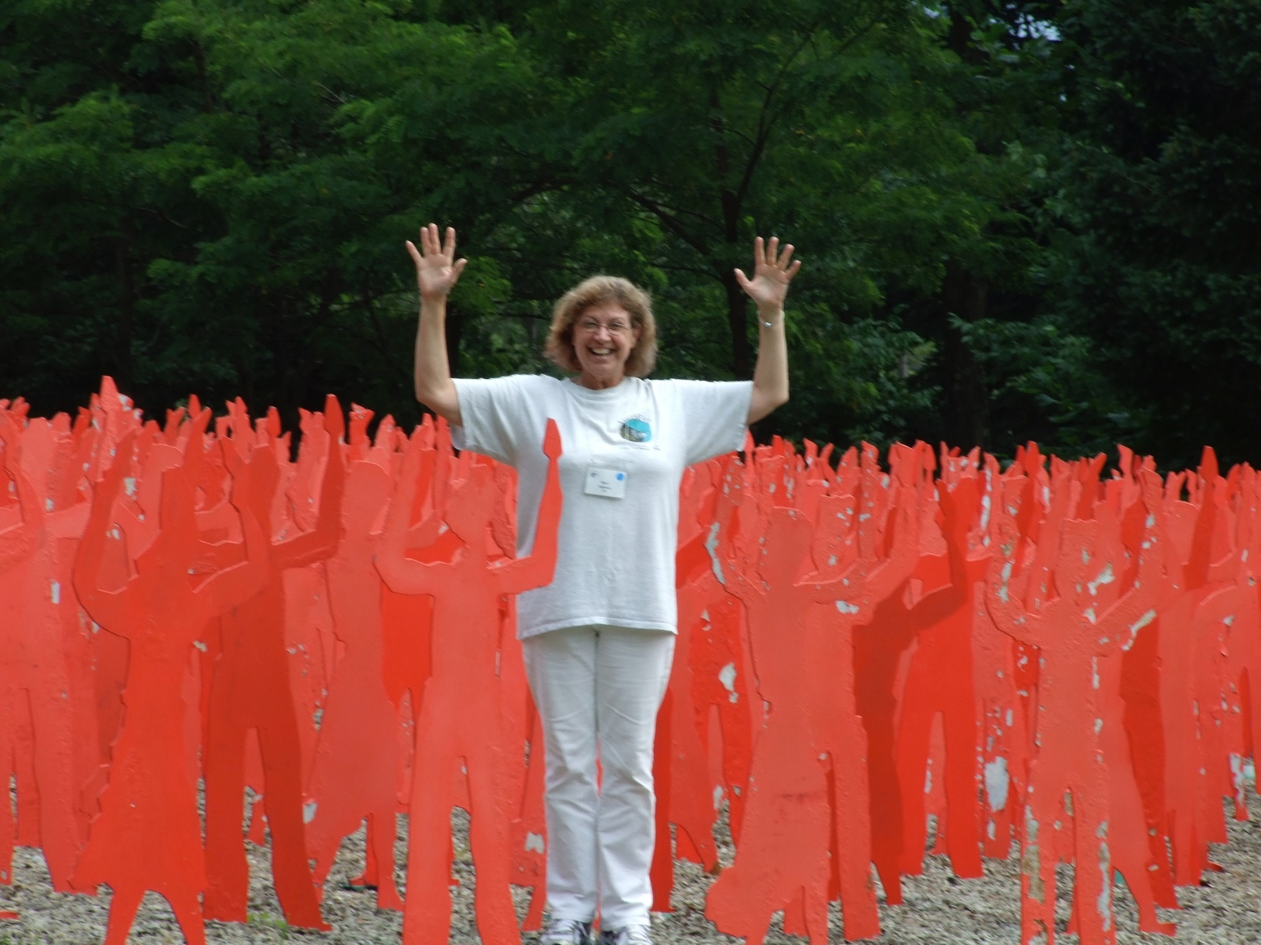
31.
Everyone volunteers to be part of the ISCEV Olympics

Slide 32
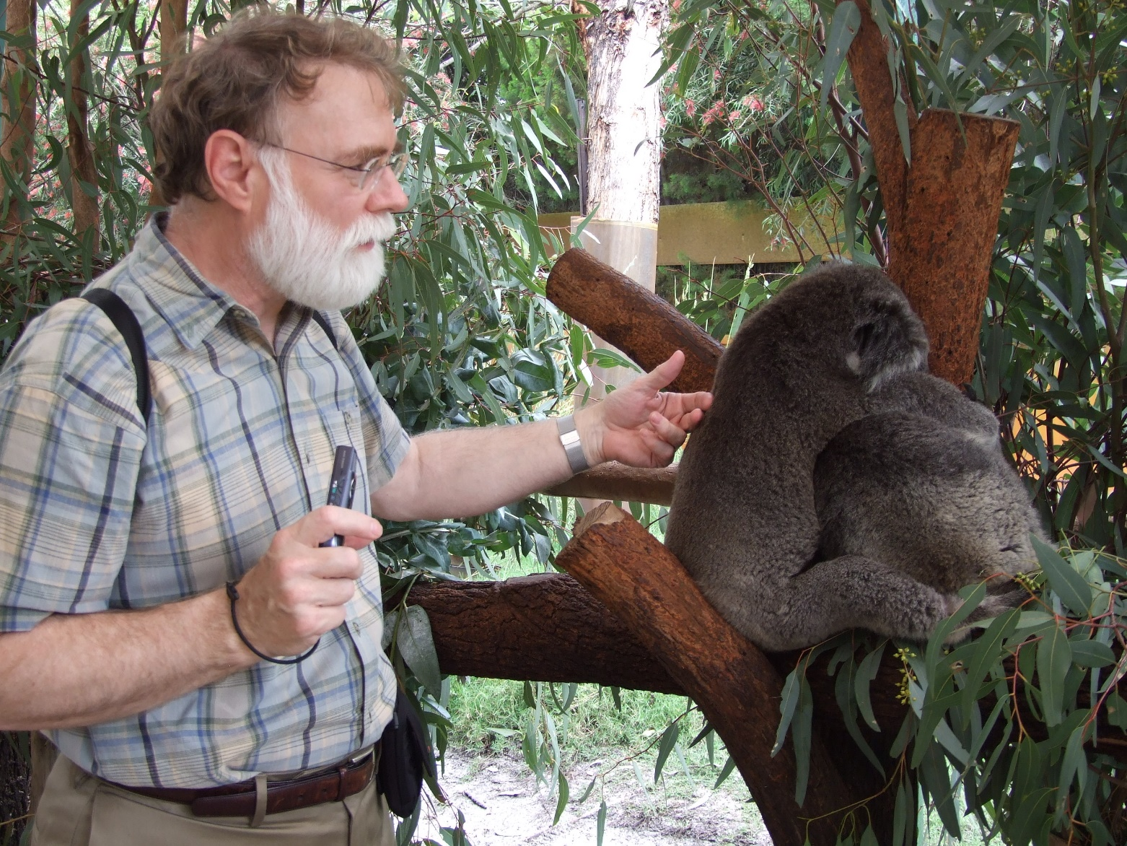
32.

Slide 33
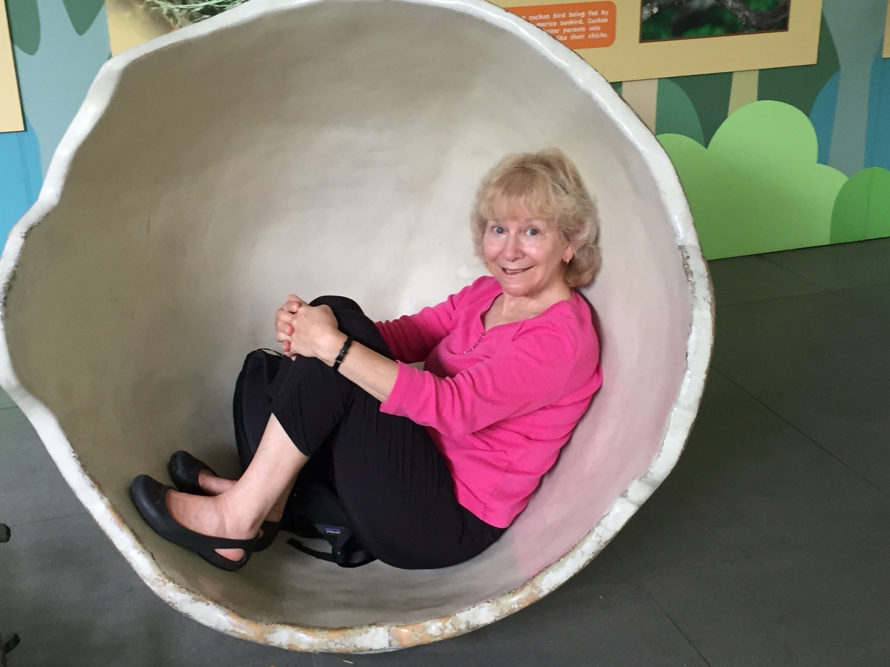
33.
Hatching a new plot?

Slide 34
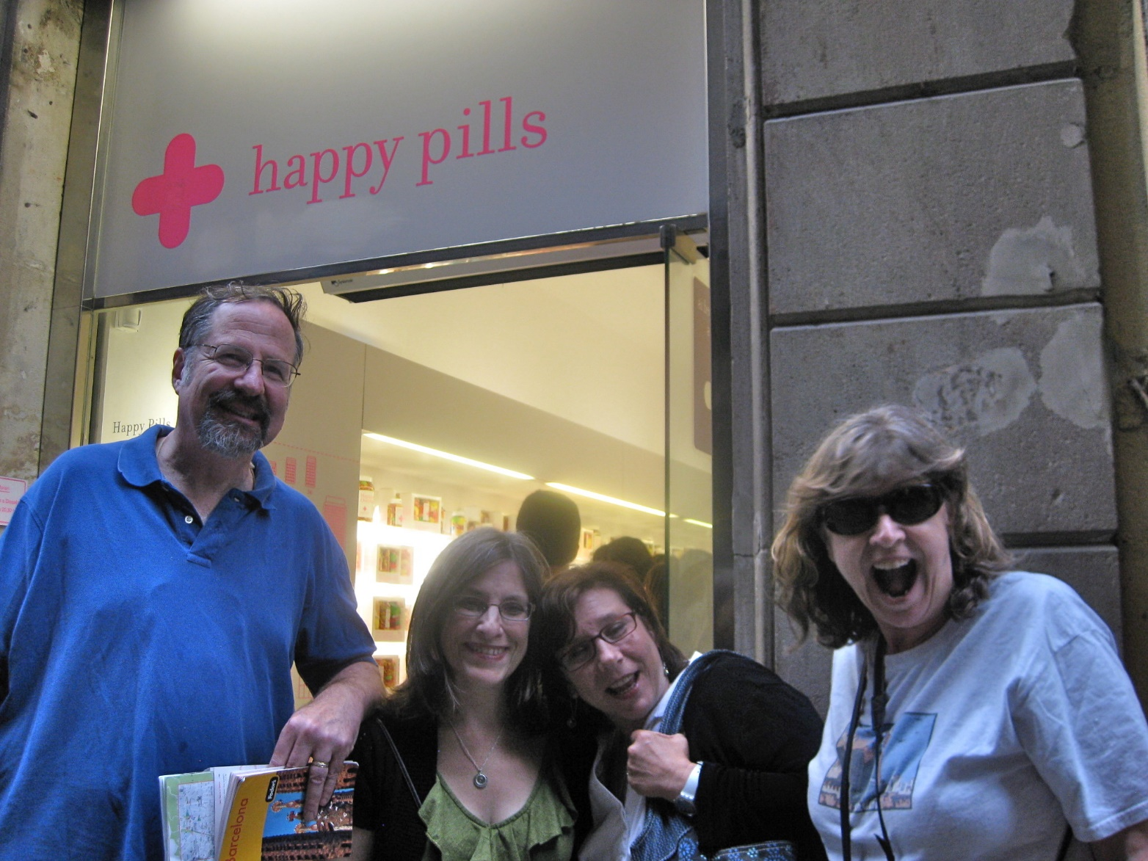
34
Some people look excited, others know what’s coming.

Slide 35
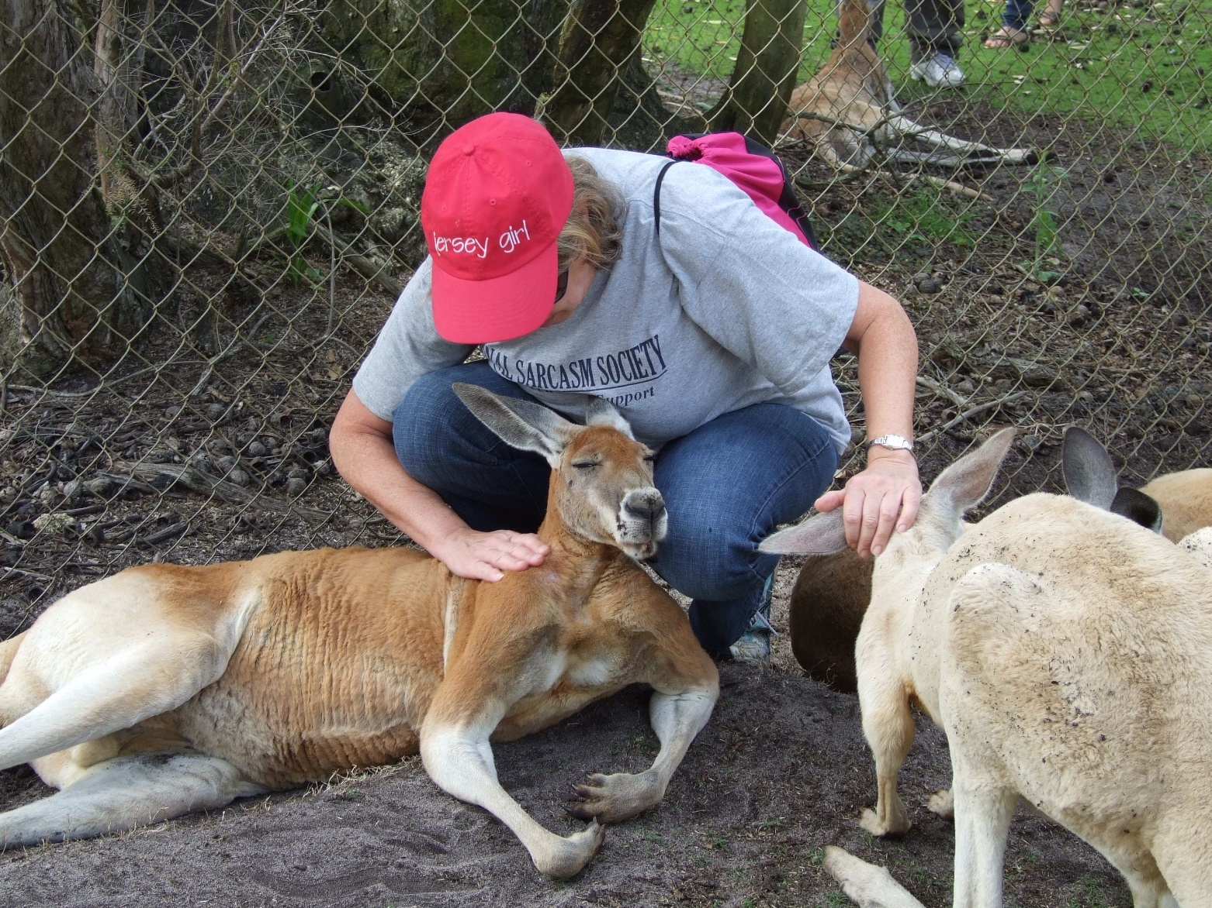
35.

Slide 36
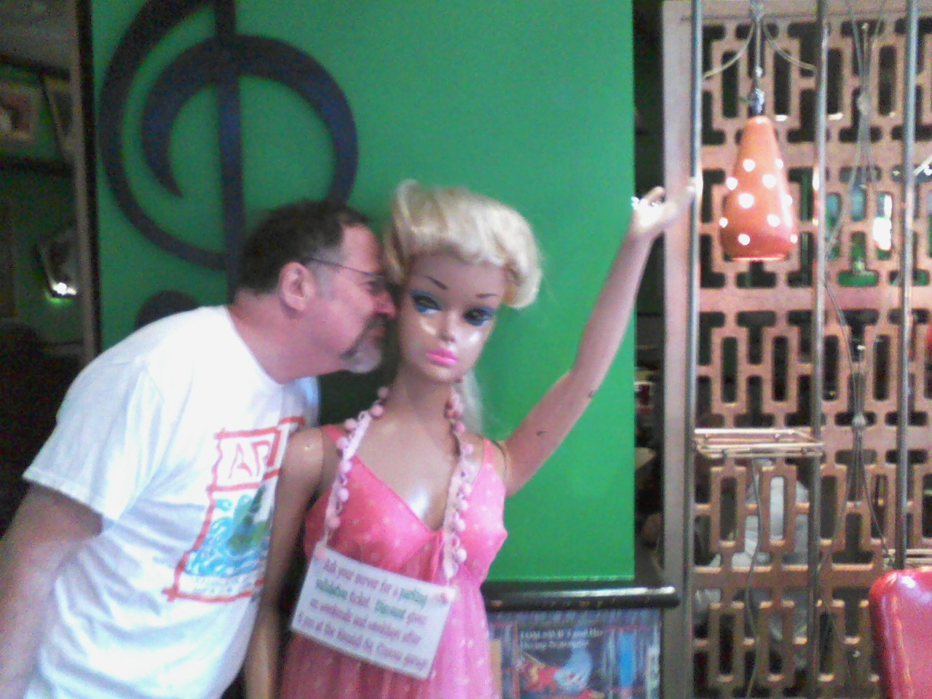
36.
Can anyone spot what’s wrong here?

